Slide 1


Career Quest Homeschool Edition
Explore real careers. Discover your path.
CURRICULUM OVERVIEW
What Students Will Do
Explore careers based on interests and strengths
Take the SkillPointe Career Quiz
Research careers, training, and opportunities
Participate in discussions and reflection activities
Learn about real-world career pathways
Format
Guided discussion and reflection
Independent exploration activities
Flexible pacing for homeschool environments
Printable and reusable learning tools

Slide 2
Facilitator Guide
How to use: Career Quest is a flexible learning system designed to be used alongside SkillPointe.com. Students will explore skills-based careers, training options, and career pathways through guided activities, reflection, and discussion.
This handout includes:
Facilitator Guide
Career Scorecards
Career Exploration Map
Phase-based learning activities
Suggested pacing: Activities are designed to support both guided instruction and independent exploration. facilitators may complete the Career Quest over several days, weeks, or as part of a larger career exploration unit.
Activities are intentionally flexible and do not require strict time limits.
Adaptations for age: Some activities include optional guidance for different grade levels.
🟢 Grades 5–8 Short responses, discussion, writing, and guided support
🔵 Grades 9–12 Independent research, comparison, and written reflection
Additional resources: SkillPointe.com includes career information, training resources, financial aid guidance, and AI-powered career exploration tools.
Select supporting visuals were AI-generated for illustrative purposes
Do you have tips or ideas to share with other educators?
Visit: skillpointe.com/contact-us

Slide 3
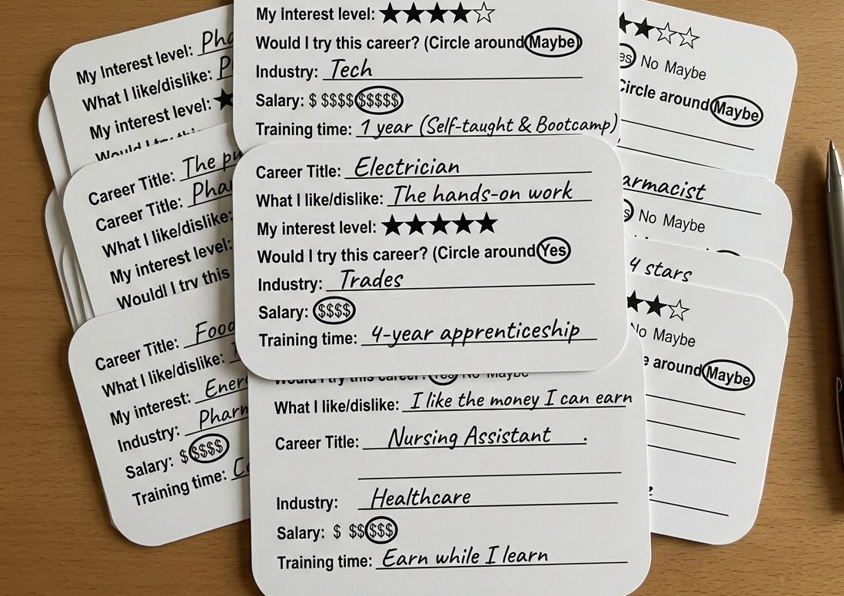
Career Scorecards
Instructions: Duplicate or print additional scorecards as needed.
Students should complete one scorecard for each career they explore on SkillPointe.com. Use the cards to compare careers, identify favorites, and discuss next steps.
facilitators may also gather and review completed scorecards as part of group discussion activities.
Students can return to Jeremy, SkillPointe’s AI career coach, at any time for additional career insights and recommendations.

Slide 4


Career Title
Student Name
Quest #
Career Title
Student Name
Quest #
Career Card
Career Card
My Interest level: ☆ ☆ ☆ ☆ ☆
Would I explore this career further? Yes No Maybe
What I like/ dislike:
Industry:
Salary: $ $$ $$$ Training time:
My Interest level: ☆ ☆ ☆ ☆ ☆
Would I explore this career further? Yes No Maybe
What I like/ dislike:
Industry:
Salary: $ $$ $$$ Training time:

Slide 5
Start your Career Quest
Use the Career Exploration Map to guide your journey through the four phases of Career Quest:
Discover > Investigate > Evaluate > Apply
You may revisit activities, repeat phases, or continue exploring careers at any time.

Slide 6
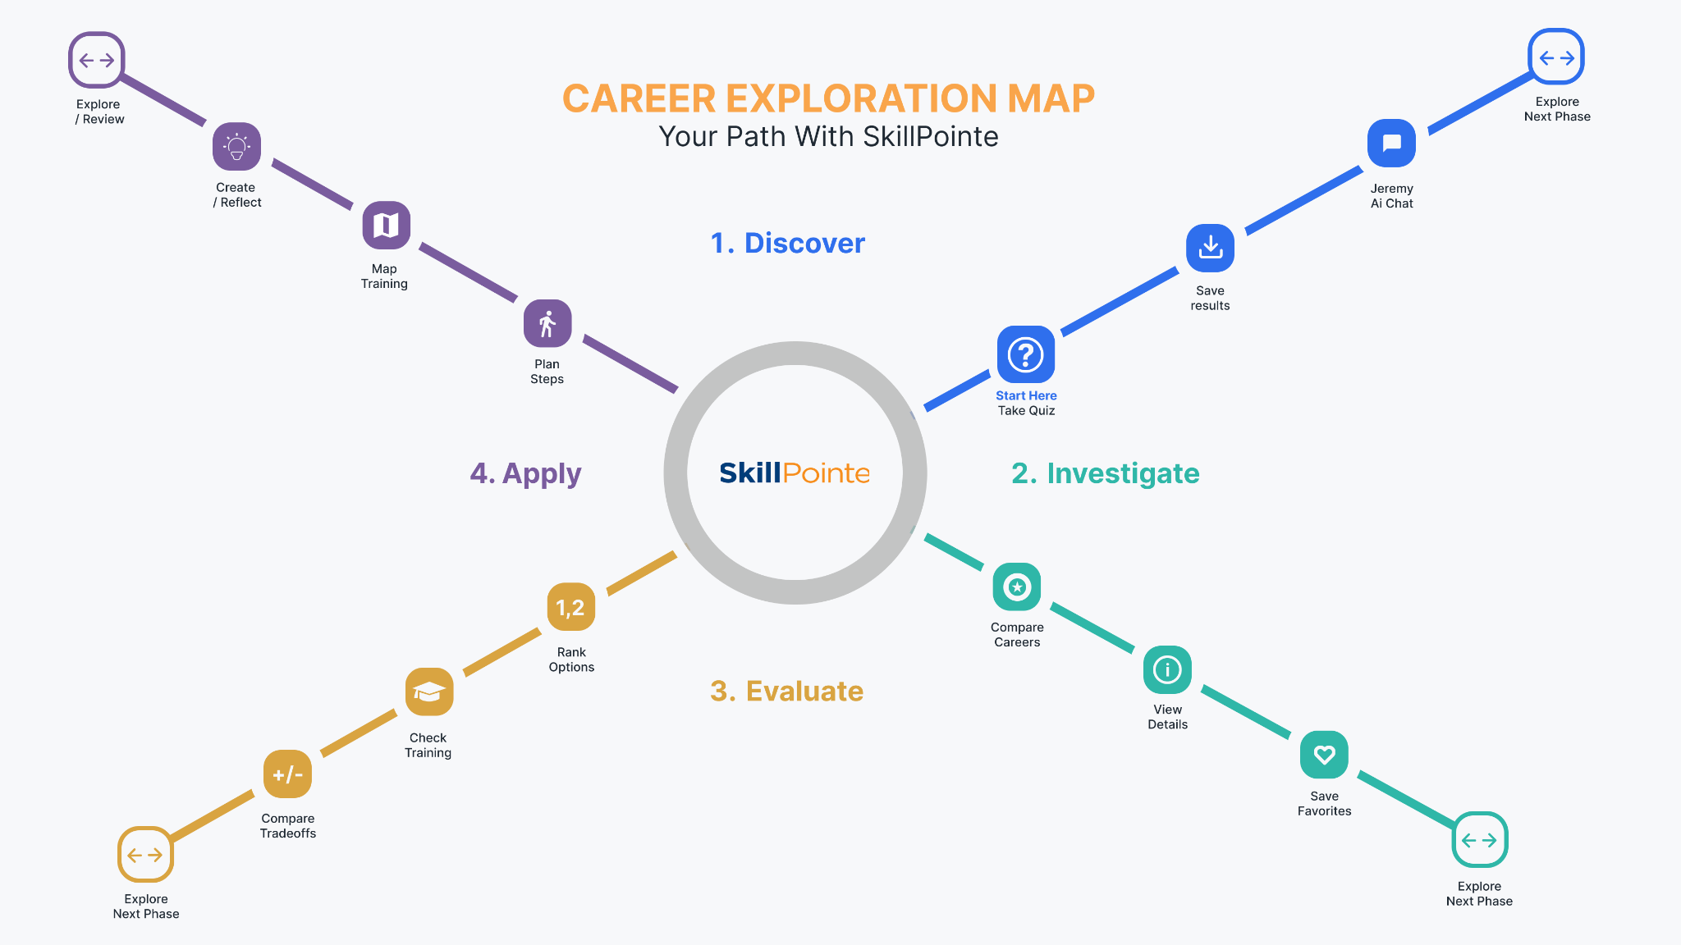

Slide 7


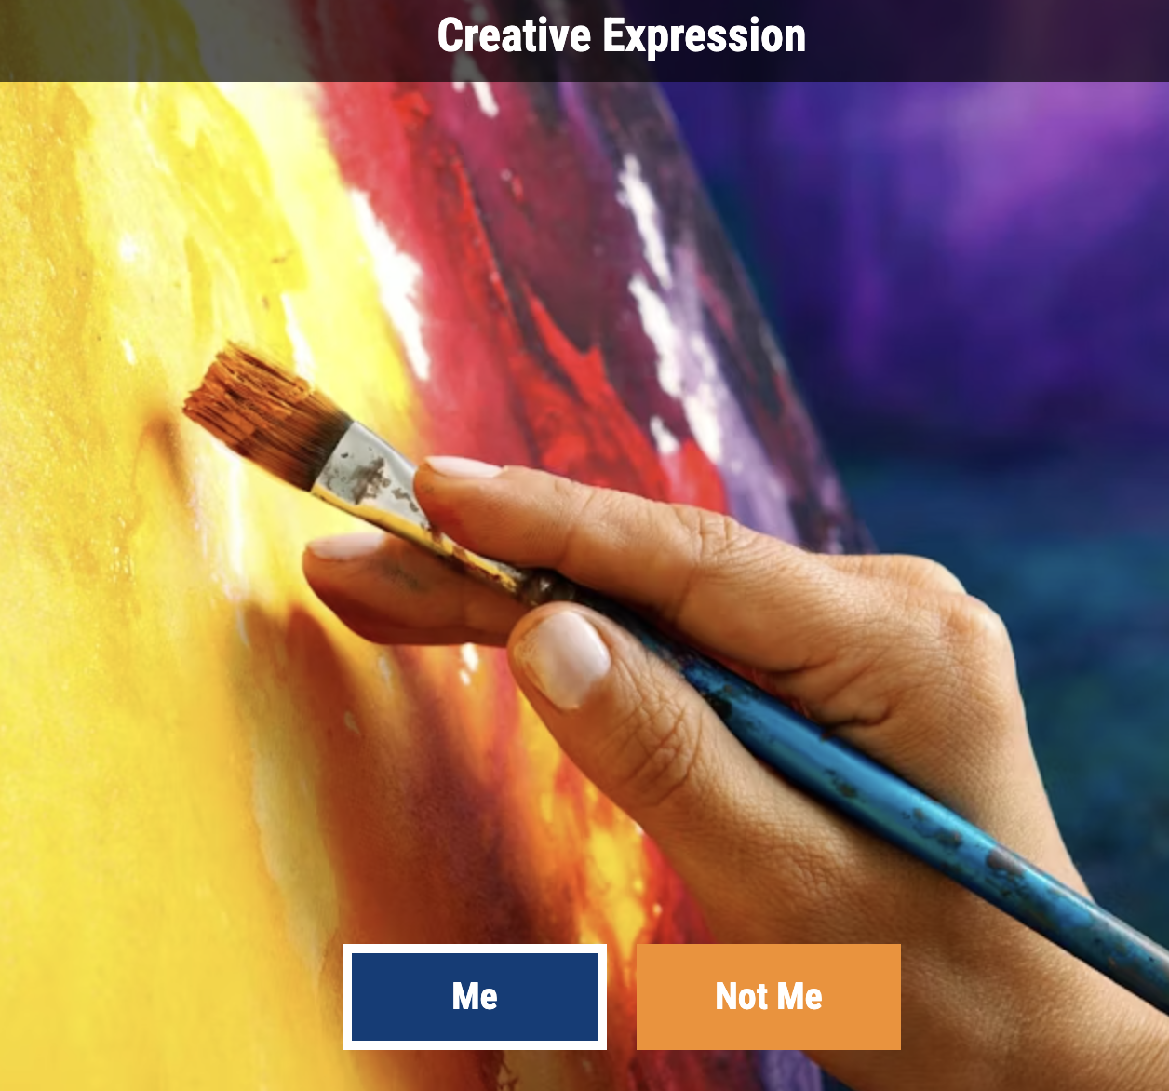
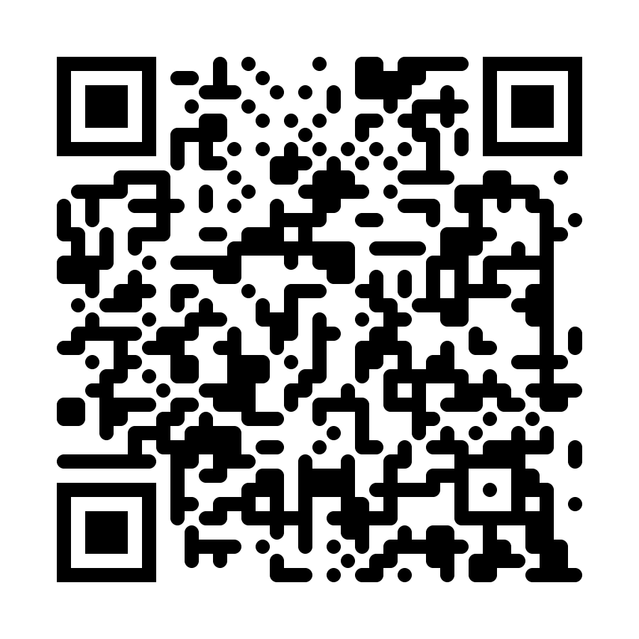
Name_________________________ Date_________ Career Quest #___ P1
1. Discover – Learn about your interests and strengths
Activity 1: Take the Career Quiz
🔍 Begin your Career Quest by taking the SkillPointe Career Quiz.
This short skills-matching quiz helps identify careers and industries connected to your interests and strengths. It can also introduce careers you may not have considered before.
Activity 2: Save & Review Results
🔍 Save your Career Quiz results and review your top career matches on SkillPointe.com.
🟢 Grades 5–8 → Independent or with facilitator guidance
🔵 Grades 9–12 → Complete independently and summarize your top matches
Reflection:
Take a few moments to think about the following:
Which career results surprised you?
Which quiz questions made you think the most?
Did any careers feel like a strong match?
Scan to Begin

Slide 8



Name_________________________ Date_________ Career Quest #___ P2
1.Discover continued – Learn about your interests and strengths
Activity 3: Explore Careers with Jeremy AI
🔍 Use SkillPointe’s AI career coach, Jeremy, to explore careers related to your quiz results and interests.
Ask Jeremy questions about:
daily responsibilities
training requirements
salary expectations
related career paths
🟢 Grades 5–8 → Choose two careers to explore
🔵 Grades 9–12 → Compare and contrast three careers and
training paths
Activity 4: Continue Exploring
🔍 Decide whether you would like to continue exploring careers in the Discover phase or move forward to the Investigate phase.
You may revisit the Career Quiz or continue speaking with Jeremy at any time.
🟢 Grades 5–8 → Record key observations about careers that
interest you
🔵 Grades 9–12 → Write a short comparison paragraph about
your top career choices
facilitator-Led Discussion:
Which careers interested you the most?
What skills seem most important in those careers?
Did any careers feel unexpected or new to you?

Slide 9


Name_________________________ Date_________ Career Quest #___ P3
2.Investigate – Research careers that match your interests
Activity 1: Compare Two Careers
🔍 Compare two careers using information from SkillPointe.com.
Compare:
salary range
training time
work environment
daily responsibilities
🟢 Grades 5–8 → Make a comparison chart
🔵 Grades 9–12 → Write a compare/contrast summary
Activity 2: Career Deep Dive
🔍 Choose one career and research it in greater detail.
Research:
daily tasks
tools and technology used
skills needed
work settings
🟢 Grades 5–8 → Identify key findings and explain what stands
out most
🔵 Grades 9–12 → Summarize findings in a couple of
paragraphs
facilitator-Led Discussion:
Which career feels most interesting right now?
Which careers require the most training?
Which career environment sounds most appealing?

Slide 10


Name_________________________ Date_________ Career Quest #___ P4
2.Investigate Continued – Research careers that match your interests
Activity 3: Explore Training Paths
🔍 Use SkillPointe and Jeremy to explore training pathways connected to careers that interest you.
Research:
certifications
apprenticeships
technical schools
degree programs
🟢 Grades 5–8 → Identify two possible training options
🔵 Grades 9–12 → Compare multiple training pathways
and requirements.
Activity 4: Find Related Careers
🔍 Explore careers that are similar or connected to your top career choices.
Think about:
transferable skills
similar industries
career advancement opportunities
🟢 Grades 5–8 → List and rank related careers
🔵 Grades 9–12 → Explain how careers are connected
facilitator-Led Discussion:
Which careers seem connected to each other?
Did you discover any new career options?
Which pathways seem most achievable right now?

Slide 11


Name_________________________ Date_________ Career Quest #___ P5
3.Evaluate – Compare options and identify strong matches.
Activity 1: Rank Your Top Careers
🔍 Use your Career Scorecards to rank your top career choices.
Think about:
interests
skills
salary
training time
work environment
🟢 Grades 5–8 → Rank your top three careers
🔵 Grades 9–12 → Explain why you ranked careers in this order
Activity 2: Career Scorecard Review
🔍 Review and compare your completed Career Scorecards.
Discuss:
similarities between careers
strongest matches
careers you may want to explore further
🟢 Grades 5–8 → Share favorite career choices
🔵 Grades 9–12 → Discuss patterns and tradeoffs
Reflection:
Which careers seem like the best fit for you?
What matters most when choosing a career?
Did your opinions change during the Career Quest?

Slide 12


Name_________________________ Date_________ Career Quest #___ P6
3.Evaluate Continued – Compare options and identify strong matches.
Activity 3: Real-World Tradeoffs
🔍 Compare real-world factors that may influence career decisions.
Compare:
training time
cost of education
salary potential
schedule flexibility
job outlook
🟢 Grades 5–8 → Write about how the real-world factors
compare for two career choices
🔵 Grades 9–12 → Write a summary of the key real-world
factors and why they would influence your
possible career path.
Activity 4: Discuss Your Choices
🔍 Discuss your top career choices with a facilitator, parent, or group.
You may also revisit previous phases or continue researching careers before moving to the Apply phase.
🟢 Grades 5–8 → Share favorite careers and explain why
🔵 Grades 9–12 → Discuss strengths, concerns, and next steps
facilitator-Led Discussion:
Which career feels like the strongest match now?
What tradeoffs are most important to you?
Which careers would you like to continue exploring?

Slide 13


Name_________________________ Date_________ Career Quest #___ P7
4.Apply – Turn ideas into next steps
Activity 1: Create a Career Timeline
🔍 Create a simple timeline showing the steps needed to begin your chosen career path.
Include:
education or training
certifications
apprenticeships
first job opportunities
🟢 Grades 5–8 → Create a visual timeline
🔵 Grades 9–12 → Create a detailed step-by-step pathway
Activity 2: Map Local Training Options
🔍 Research opportunities near your community.
Use SkillPointe.com to identify:
nearby training programs
certifications
apprenticeships
technical schools
🟢 Grades 5–8 → Identify one local option
🔵 Grades 9–12 → Compare multiple local training opportunities
Reflection:
Which next step feels most achievable?
What training path interests you most?
What would you like to learn more about?

Slide 14


Name_________________________ Date_________ Career Quest #___ P8
4.Apply Continued – Turn ideas into next steps
Activity 3: A Day in the Life
🔍 Imagine a typical day working in a career that interests you.
Use what you learned during Career Quest to describe:
work responsibilities
schedule
tools used
challenges and rewards
🟢 Grades 5–8 → Write about a day in the life
🔵 Grades 9–12 → Write a detailed journal entry or reflection
Activity 4: Plan Your Next Step
🔍 Decide what you would like to explore next in your Career Quest journey.
You may:
revisit earlier phases
explore additional careers
continue researching training pathways
begin planning future education goals
🟢 Grades 5–8 → Outline your next steps with notes
🔵 Grades 9–12 → Create a short action plan for next steps
facilitator-Led Discussion:
What did you learn about yourself during Career Quest?
Which career pathway interests you most now?
What would you like to explore next?

Slide 15
Student Notes
Name_________________________ Date_________ Career Quest #___ P9

